Slide 1

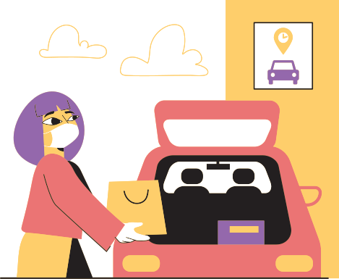
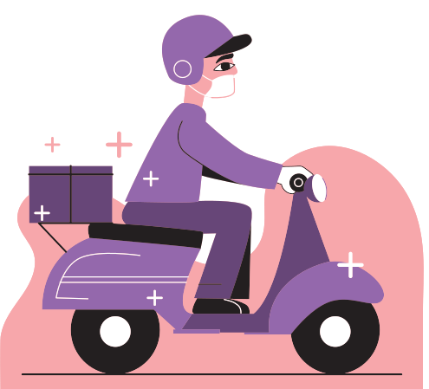
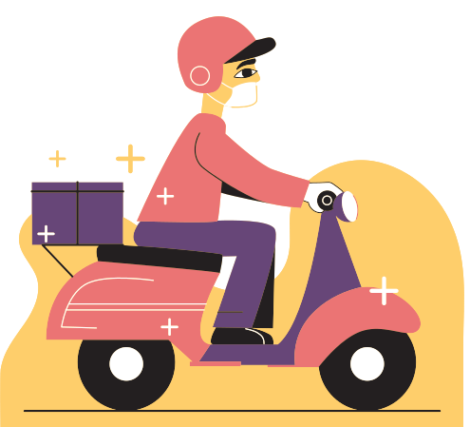
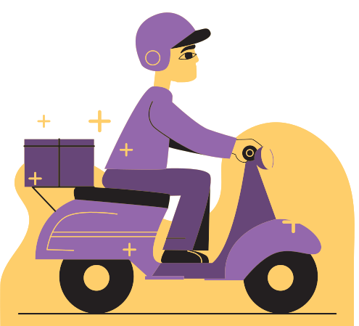
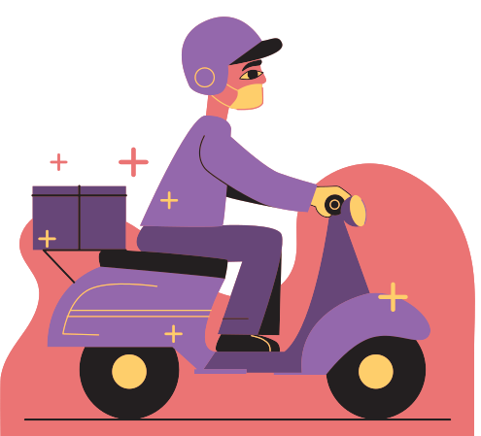
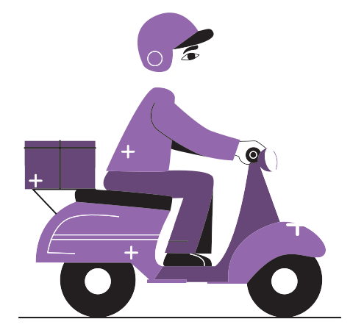
SHOPPING CART
BY :TILAK RAJ

Slide 2

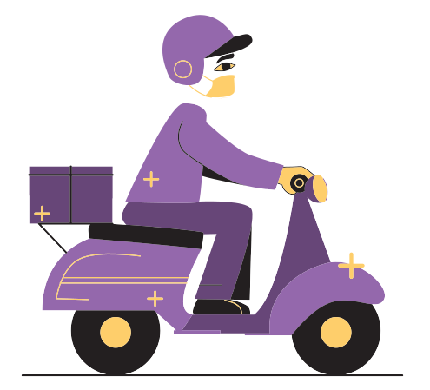
Topic Outline
A
ONLINE SHOPPING
B
ADVANTAGES AND DISADVANTAGES
C
SHOPPING CART IN PYTHON

Slide 3
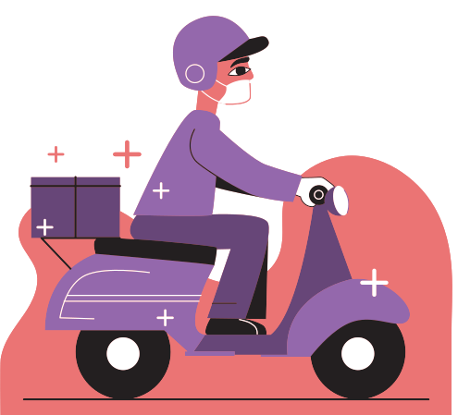
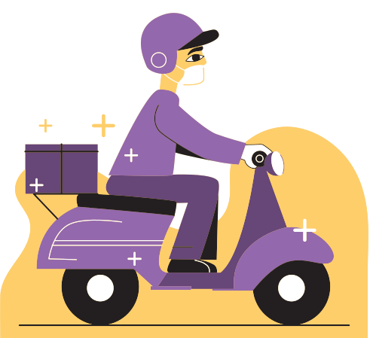
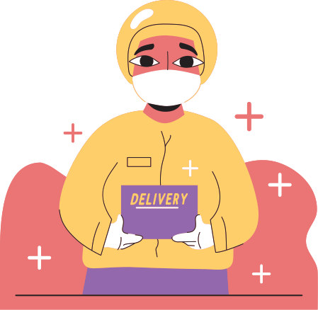
ONLINE SHOPPING

Slide 4
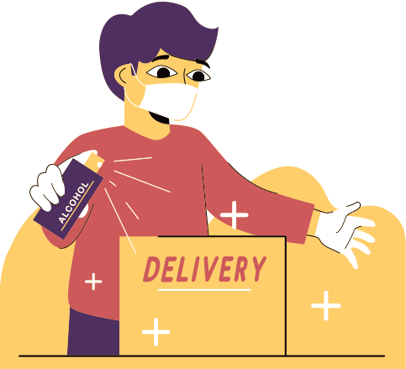
Introduction
  Online shopping is a form of
electronic commerce which
allows consumers to directly buy
goods or services from a seller
over the Internet using a web
browser or a mobile app.
  Consumers find a product of
interest by visiting the website of
the retailer directly or by
searching among alternative
vendors using a shopping search
engine, which displays the same
product's availability and pricing
at different e-retailers.

Slide 5

What are the advantages and disadvantages?
Advantages
  S h o p p i n g S e c r e c y
  E a s y R e p l a c e A n d R e f u n d
  Cr o w d A v o i d a n c e
  V a ri e t y o f P r o d u c t s M o d e r n
  Co n v e n i e n c e O n l i n e
  D i s c o u n t s

Slide 6
What are the advantages and disadvantages?
Disadvantage
  R i s k o f fr a u d
  L e s s c o m m u n it y c o n t a c t
  L a c k o f t o u c h w it h it e m s
  No s u p p o rt f o r l o c a l r e t a i l e r s
  L a c k o f s h o p p i n g e x p e ri e n c e
  No s u p p o rt f o r l o c a l r e t a i l e r s

Slide 7


input
0utput

Slide 8
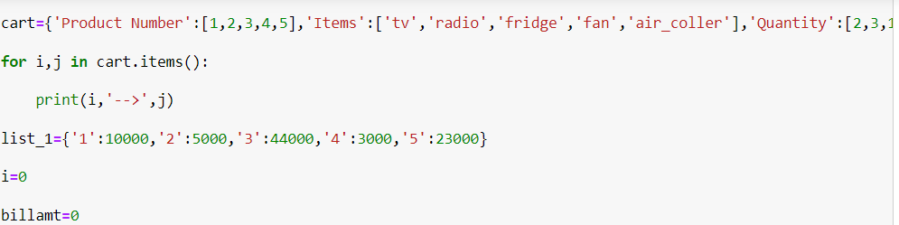

input
0utput

Slide 9
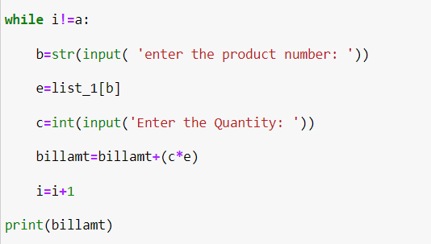
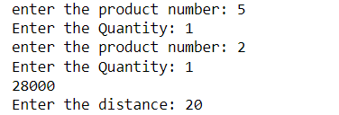
input
0utput

Slide 10
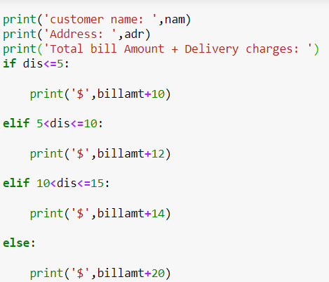
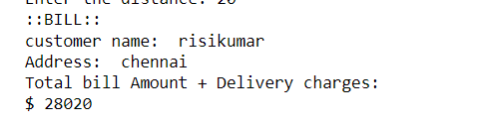
input
0utput

Slide 11

Thank you for listening!

